Slide 1
Work flow and customer’s journey presentation

Slide 2
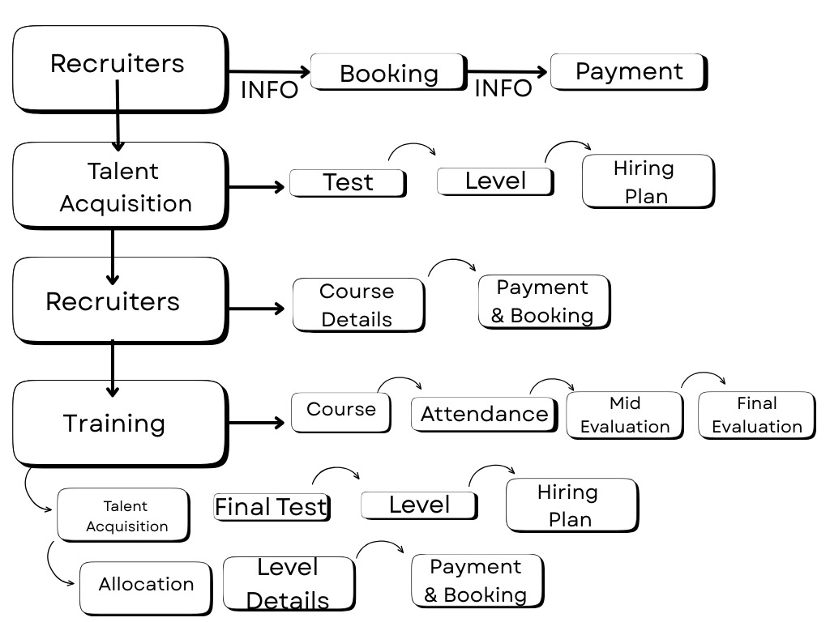

Slide 3
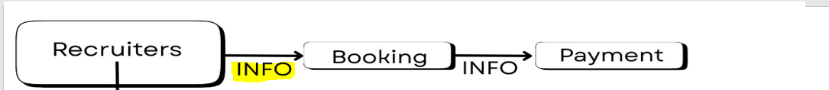
Stage (1) Recruiters :
At this stage, recruiters or the sales team conduct calls to introduce our programs and book candidates for the placement test. During the call, recruiters are required to collect essential information from the candidate. A dedicated sheet will be attached outlining the required data, along with the sheet or form currently used for this step.
N.B: What we need to add to the system is that recruiters will not be able to proceed to the next step of booking the placement test unless all required information has been fully completed.**

Slide 4
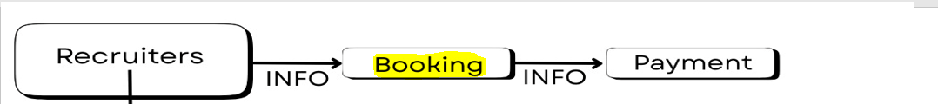
Stage (2) booking a placement test :
Once recruiters are on the call with the candidate, after gathering all required information and explaining all relevant details, the next step is to book a placement test for the candidate. At this stage, there are two available options: an online test or an onsite test.
On the system we need to add a booking page for placements.
Sheets that we currently use for gathering candidates’ information and booking them will be attached for further review.

Slide 5

Stage (3) Payment:
At this stage, after agreeing on the placement test date, time, and venue (online or onsite), the candidate has two payment options: online payment (transfer) or onsite payment at the time of the placement test.
N.B: At this stage, a mandatory checkbox must be added to the system to indicate the status of Payment along with the reason for pending cases and whether the trainee paid onsite or online.
Payment – Done
Payment – Pending
This step must be completed before proceeding to the next stage no one can proceed to next step unless this step is completed **

Slide 6

Stage (4) The placement test :
Once the placement test date and time arrives (online or onsite), the Talent Acquisition team is responsible for conducting the test and providing language feedback to the candidate.
N.B: At this stage, a mandatory checkbox must be added to the system to indicate the status of language feedback: In case of Pending, a reason must be mentioned (drop-down menu)
Language feedback conducted – Done
Language feedback conducted – Pending
Reason “drop-down menu” includes 2 options: 1) Validation and 2) Call no answer
This step must be completed before proceeding to the next stage no one can proceed to next step unless this step is completed **
Also the sheet of language feedback that we are currently using will be shared.

Slide 7

At this stage, a mandatory checkbox must be added to the system to indicate the status of Arrival (online/onsite ):
showed
No show
And if we can add as well the exact time of showing up (online/onsite) for the placement.
After showing up for the placement test there will be further information required to complete before taking the placement test a sample of the further required information will be attached for further review.

Slide 8

Stage (5) Level allocation:
After the placement test is done and the talent acquisition provides language feedback and checks the box on the system the recruiter responsible originally for the candidate will be responsible again for providing level allocation and closing the candidate.
N.B: At this stage, a mandatory checkbox must be added to the system to indicate the status of allocation feedback (level):
Allocation feedback provided– Done
Allocation feedback provided– Pending
Pending reason: 1) No Answer 2) Call Back 3) Validation
This step must be completed before proceeding to the next stage no one can proceed to next step unless this step is completed.**
Also the sheet of level allocation that we are currently using will be shared.

Slide 9
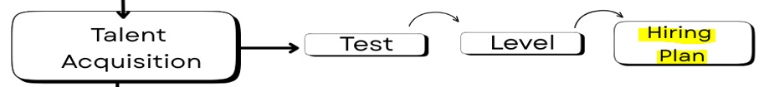
Stage (6) Hiring plan:
The Hiring Plan is prepared by the Training Lead and outlines the available classes scheduled to start each month. This plan is reviewed and updated on a monthly basis.
Once the allocation level is confirmed and payment is completed, the system must automatically assign the candidate to the appropriate class based on their allocated level.
For example, if a trainee named Hisham completes the placement test and is allocated an A1.1 level, the system should automatically reflect his enrollment in the earliest available January A1.1 class until the number of trainees reaches the requested number (12) .
Hiring plan example will be attached for further review and the next slide will contain an example for it.

Slide 10
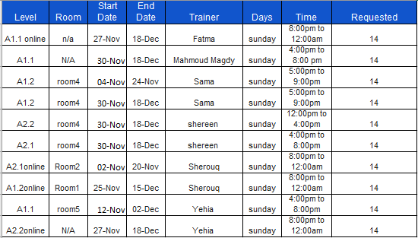
Hiring plan example:

Slide 11

Stage (7) course details and Payment:
At this stage, once the trainee’s level is clearly reflected on the system, the recruiter proceeds with confirming the level allocation and collecting the payment from the candidate.
After payment, the system must include a mandatory checkbox to indicate the payment status (Paid / Not Paid), which will automatically reflect on the hiring plan.
Another mandatory checkbox is for the Training Agreement (Signed/Not signed)
This step must be completed before proceeding to the next stage no one can proceed to next step unless this step is completed **

Slide 12
Stage (8) course enrollment and Training department:
Now that the candidate has started their training, before the training begins, the following documents are required to ensure a smooth process:
Prior to the training:
At least one day before the training, the Allocation Team should send the initial expected list of the class, including trainees’ names and contact numbers. The sheet will be attached for review.
During the training, we will have:
Attendance sheet – to track trainees’ adherence.
Performance report (SSR) – to monitor progress.
Evaluations – conducted by the Talent Acquisition department (mid and final evaluations).
Assignments – sent by the trainer to the trainees.
Initial language details – provided by the Talent Acquisition and Allocation departments.
All of the above documents will be attached in detail for further review.

Slide 13
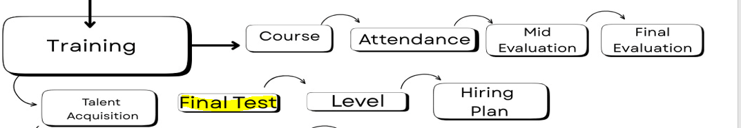
Stage (9) Post Training: Final evaluation
After trainees complete their training, they undergo a final evaluation at the end of the program to track their progress and determine reallocation. Following this, they return to the Talent Acquisition (TA) team for retesting and reallocation. Accordingly, the cycle starts again—conducting the test, providing language feedback, allocating the new level, and reflecting this in the hiring plan.
Currently, the Allocation Team is responsible for following up with trainees and providing them with level feedback, rather than the Sales Team. Therefore, we will follow the same steps, and the system should incorporate the same processes outlined in slides 7, 8, and 9.

Slide 14

Stage (10) Post Training: Level allocation
After the Final evaluation is done and the talent acquisition provides language feedback and checks the box on the system, the Allocation team will be responsible for providing level allocation and closing the candidate.
N.B: At this stage, a mandatory checkbox must be added to the system to indicate the status of allocation feedback:
Allocation feedback provided– Done
Allocation feedback provided– Pending
This step must be completed before proceeding to the next stage no one can proceed to next step unless this step is completed.**
Once the allocation level is confirmed and payment is completed, the system must automatically assign the candidate to the appropriate class based on their allocated level.
Then we have the step of payment.

Slide 15
Areas Requiring Analysis from the system :
Exit Conversion Rate: Number of trainees who progressed to the next level after completing a level.
Trainee Attrition: Number of trainees who dropped out (tracked through the attendance sheet).
Number of Re-joiners: Trainees who did not pass the level according to the final evaluation and rejoined the same level.
Success Rate: Number of trainees who passed the level according to the final evaluation.
Source Analysis: Identify the sources from which we have the most trainees.
Most Common Levels: Determine which levels have the highest number of trainees.
Pending Final Evaluation: Number of trainees who did not complete their final evaluation in classes.

Slide 16
Areas Requiring Analysis from the system :
Geographic Distribution: Geographic areas where most candidates apply .
Graduation status: number of grads versus undergrads.
Age: the most predominant age group (e.g., 20-25).
Working status: number of trainees working/not working at the time of application/training.
The above can be extracted from the booking and placement data/expected list

Slide 17
Stages that would require follow up notifications from the system :
Prior to Stage 1:
For unreachable candidates, callbacks, or those who are “not interested right now.”
Stage 1 – Recruiters:
While calling a candidate, if it is not possible to book a placement on the same call, follow-up calls should be scheduled to finalize the placement.
If the candidate’s placement is booked but the process cannot proceed in the system due to missing information, a notification should remind the recruiter to call the candidate immediately to complete missing info to continue to the next stage (Booking Stage).
Stage 3 – Payment:
Pending placement test payments.

Slide 18
Stage 4 – Placements:
Candidates booked but did not show up for placements.
Stages 4 & 5:
Pending language feedback or pending level allocation in the system.
Stage 7 – Course Details and Payment:
Pending payments or payments not recorded in the system.
Stage 8 – Course Enrollment and Training Department:
1)Attendance or adherence issues.
2)Attrition cases.
Stages 9 & 10 – Post Training:
Pending or incomplete language feedback or level allocation feedback.

Slide 19
Levels that we currently provide:
Foundation.
True beginners.
A1.1.
A1.2.
A2.1.
A2.2.
B1.
B1+.
Train to hire 1
Train to hire 2.

